Slide 1
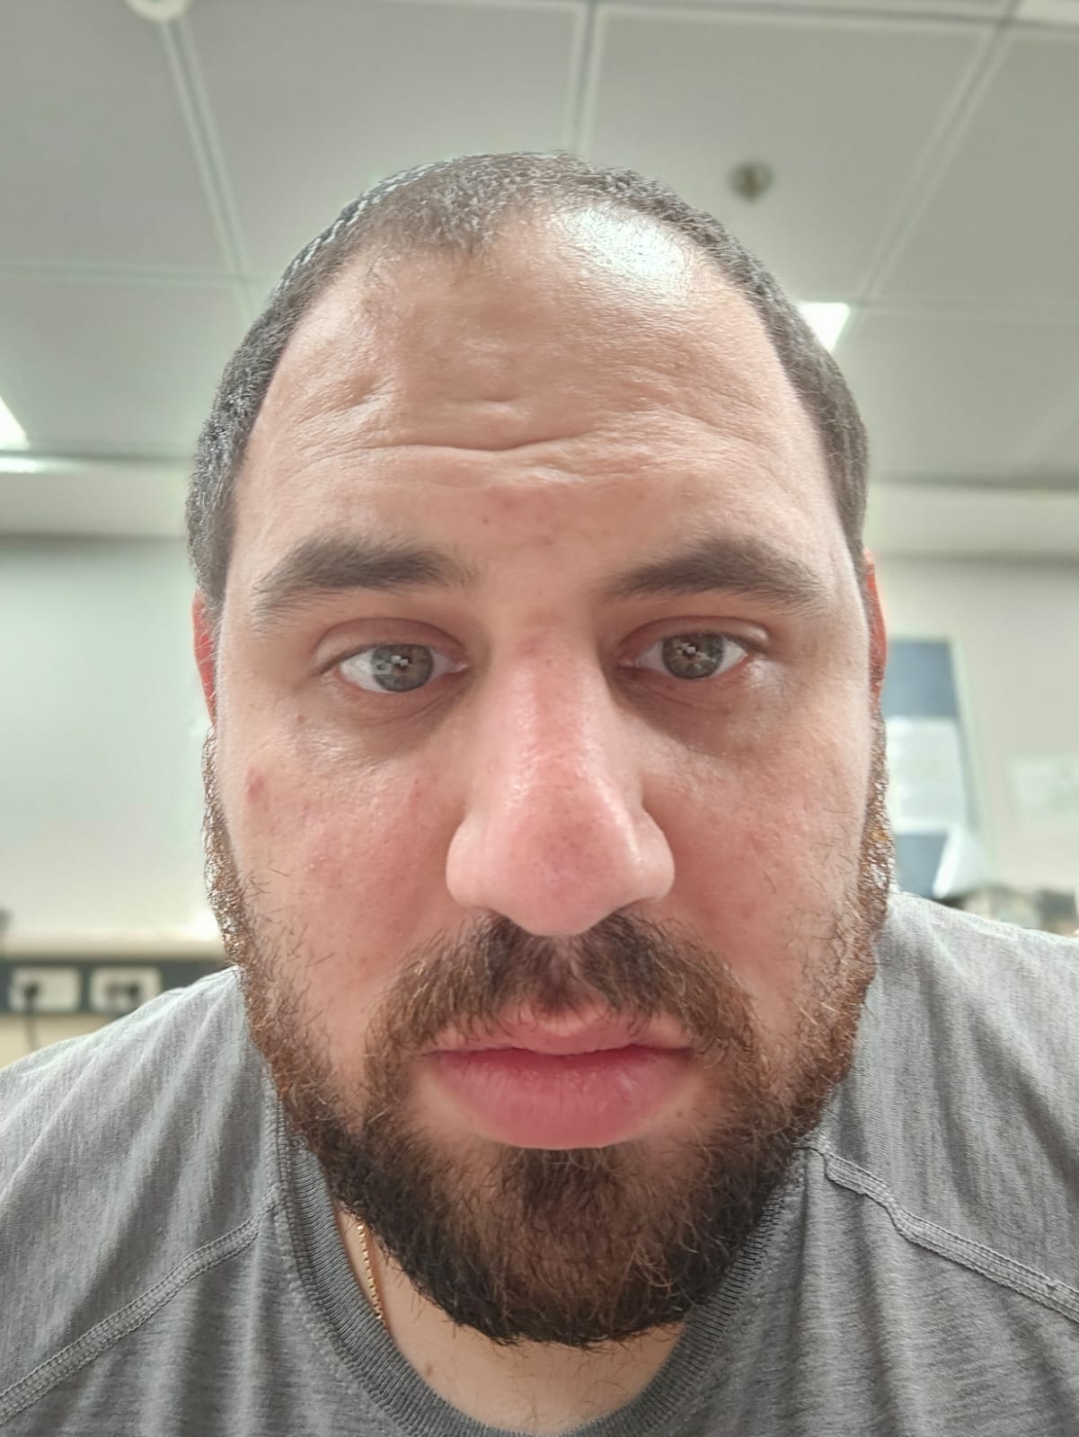
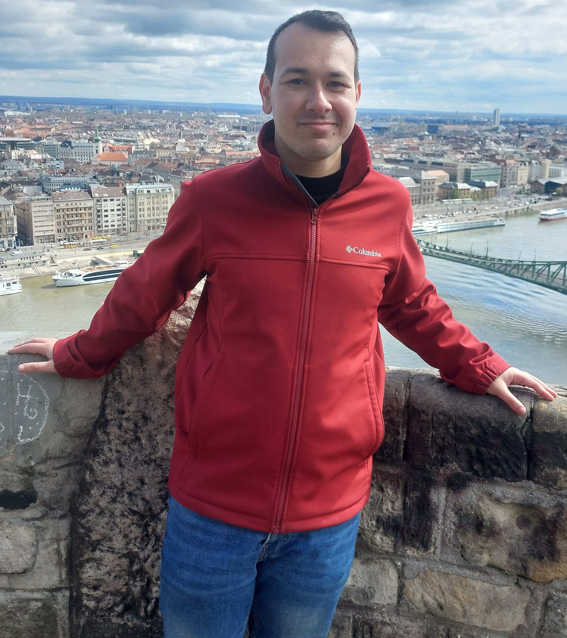

Course: Image Processing 31651 Assignment #21 Pixel to Pixel Operations (Part 1) – version 2
Photo of the student | Shorten Name | ID (4 last digits)
 | shienfeld | 1950 | Student #1
 | pony | 2210 | Student #2
 | akimov | 7939 | Student #3
Photo of the student | Shorten Name | ID (4 last digits)
 | shienfeld | 1950 | Student #1
 | pony | 2210 | Student #2
 | akimov | 7939 | Student #3

Slide 2
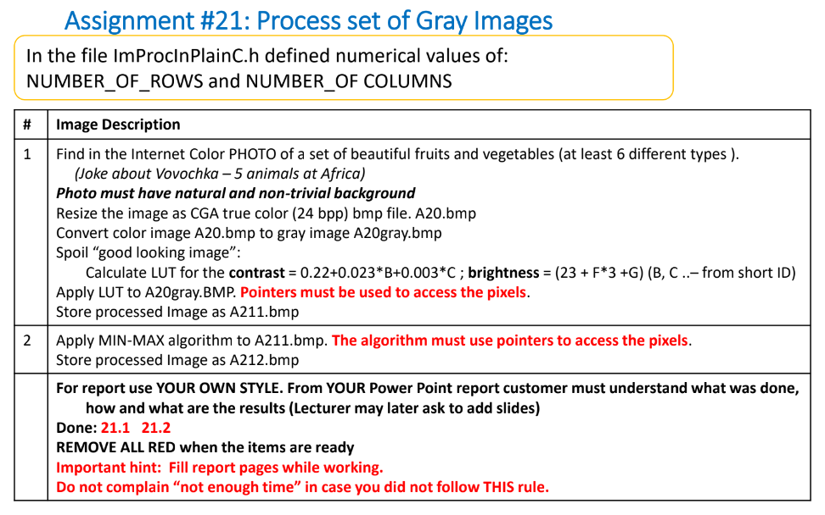

Slide 3

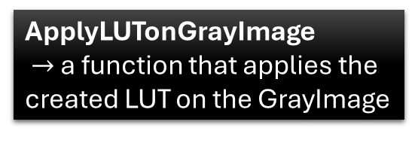
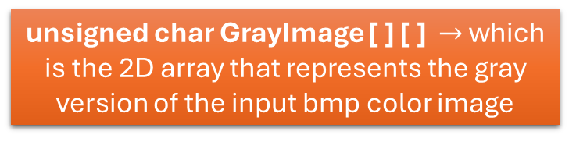
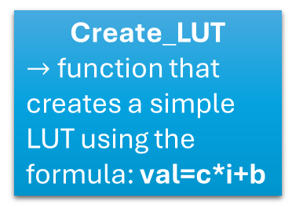

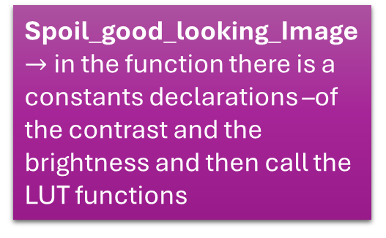
21.0 - flow chart of the code
Input : A20.bmp (320x240 dimensions and from CGA true-color (24 bpp) bmp file type)
LoadGrayImageFromTrueColorBmpFile
unsigned char GrayImage [ ] [ ] $→$ which is the 2D array that represents the gray version of the input bmp color image
Min_Max_Algorithm $→$ in the function there is a constants declarations –of the contrast and the brightness and then call the LUT functions (different constants from Spoil_good_looking_Image)
Create_LUT
$→$ function that creates a simple LUT using the formula: val=c*i+b
ApplyLUTonGrayImage
$→$ a function that applies the created LUT on the GrayImage
Spoil_good_looking_Image $→$ in the function there is a constants declarations –of the contrast and the brightness and then call the LUT functions
StoreGrayImageAsGrayBmpFile $→$Store the new GrayImage as a bmp file (after transformation using LUT)

Slide 4
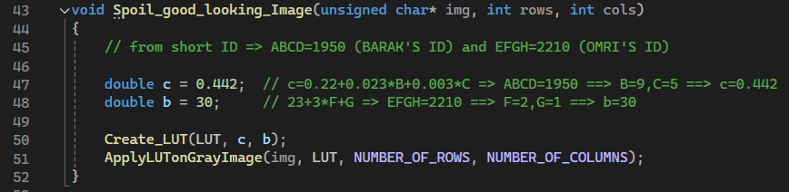
21.1 – “Spoil_good_looking_Image” function
Pay attention to ‘c’ and ‘b’ values – corresponding the IDs of the group
After ‘c’ and ‘b’ declarations – create using them a simple LUT and then apply the LUP on the gray image (img [ ] [ ] )

Slide 5
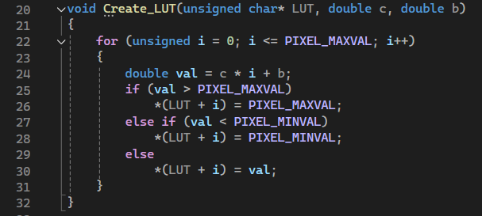
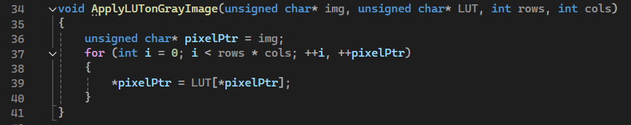
21.2 – “Create_LUT” and “ApplyLUTonGrrayImage” functions
Create_LUT is a very simple function for creating a LUT using the contrast (c) and brightness (b) constants.
After defining the LUT – we need to apply the LUT of the original gray image (img [ ] [ ] )

Slide 6
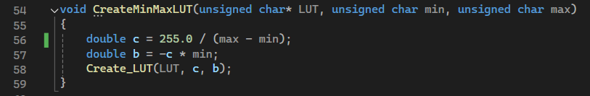
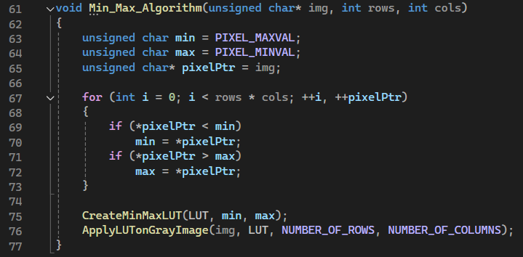
21.3 – “CreateMinMaxLUT” and “Min_Max_Algorithm” functions
Another LUT creation function – now for the min_max_algorithm.
The max value is 255 and the min value is 0 (in grayscale). Now, the ‘c’ and the ‘b’ are defined differently then they were defined for the Spoil_good_looking_Image algorithm
The first part of the function finds the minimum and maximum pixel values in the image.
min is initially set to the maximum possible pixel value (255), and max is set to the minimum possible pixel value (0).
The function then iterates through each pixel in the image. For each pixel : If the pixel value is less than min, min is updated to this pixel value. If the pixel value is greater than max, max is updated to this pixel value.
By the end of these loops, min holds the smallest pixel value in the image, and max holds the largest pixel value.
After finding the minimum and maximum pixel values, the function creates a LUT to normalize the pixel values.
Finally, the LUT is applied to the image to adjust the pixel values.

Slide 7
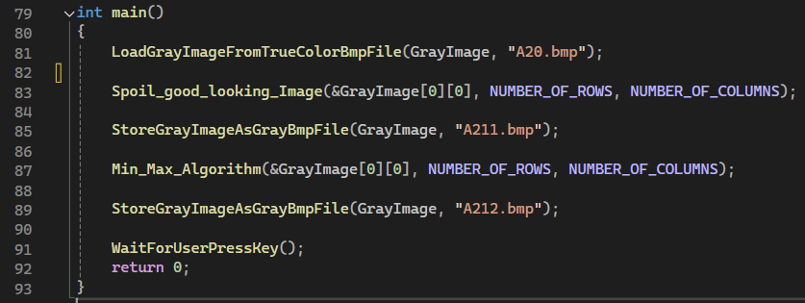
21.4 – the “main” function
Apply the two algorithms on the A20.bmp original image

Slide 8
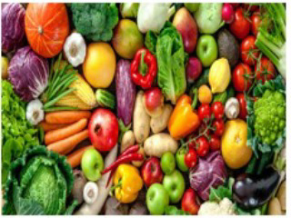
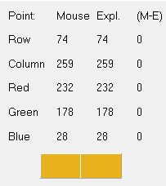
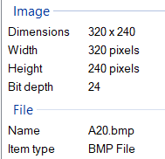
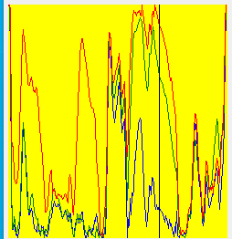
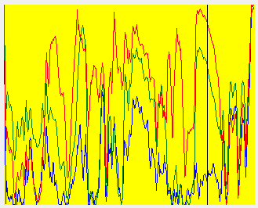
21.5 – demonstration using profiler – part 1/5
location
A20.bmp (original color image)
Through 21.5 section – we will examine one point on the images – point (74,259)
RGB values
we found on the internet a good-looking photograph consisting variety of fruits and vegetables. We resized the image to 320x240 dimensions and made sure it’s from CGA true-color (24 bpp) bmp file type.

Slide 9
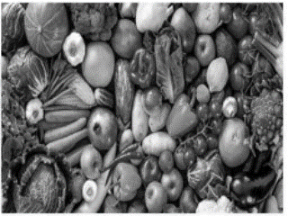
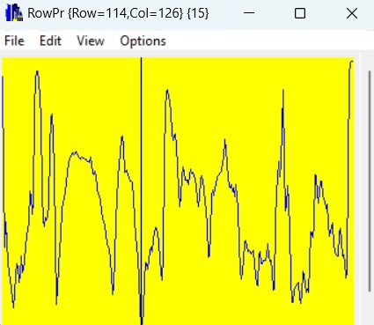
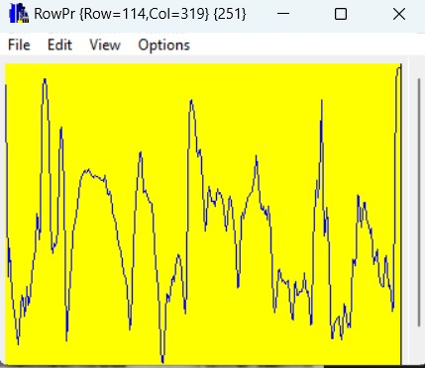
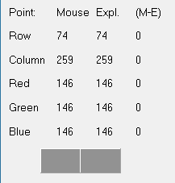
21.6 – demonstration using profiler – part 2/5
A20gray.bmp
Here we can see the gray version of the original color image we provided. The grayscale of a specific point that we examine – (74,259) – is 146 and the profilers of the image is also can be seen. Important conclusion: we see that the image consists approximately 92% of the grayscale range (according to the profilers) because highest point is 251 and the lowest is 15.
After applying the spoiling as well as the min-max algorithm we will examine that point’s grayscale and the profilers to see the effects on them.
RGB values
location

Slide 10
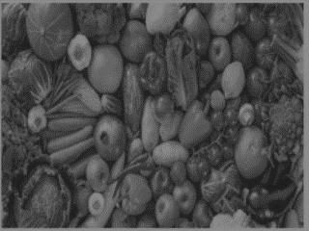
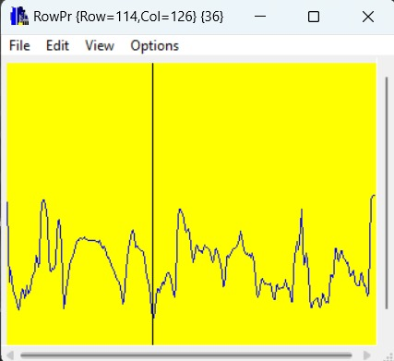
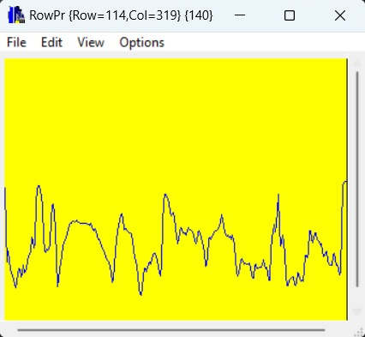
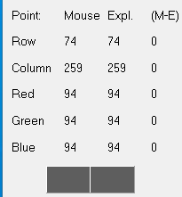
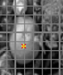
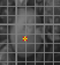
21.8 – demonstration using profiler – part 3/5
A211.bmp
We can see that spoiling the image truly ruins the image. The white parts of the original gray image got ruined and became dark – makes the image almost impossible to work with and to comprehend the true components ( in that case – the fruits and vegetables) in the original gray image. (see example in the green dashed rect below)
Regarding the profiler – we can see that regarding the point we chose – the grayscale decreased dramatically from 146 to 94 and the profilers are decreased version of the profilers of A20gray.
Important conclusion: we see that the image consists approximately 40% of the grayscale range (according to the profilers) because highest point is 140 and the lowest is 36.
That is a major decrease of the grayscale usage – and the effect is clearly seen
location
RGB values
Before spoiling
after spoiling

Slide 11
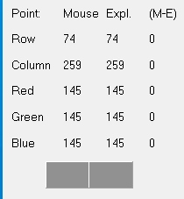

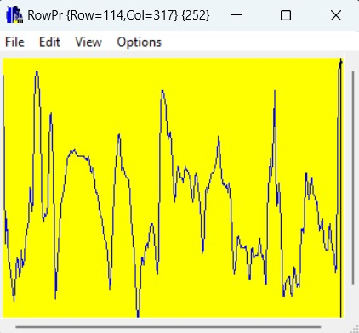
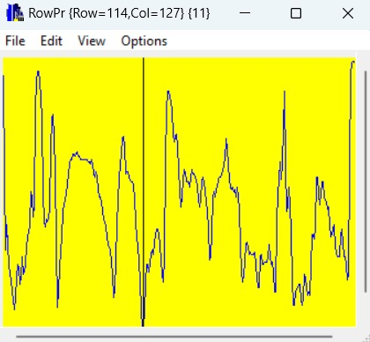
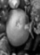
21.7 – demonstration using profiler – part 4/5
RGB values
location
We can see the min-max algorithm result – the original gray image was pretty much restored.
For point (74,259) the grayscale level was restored as well (now 145 – before 146) and the row and columns views are balanced again like before.
Closer look at the original white components in the image reveal us that the restoration succeeded in that task.
(see example in the green dashed rect below)
Important conclusion: we see that the image consists approximately 94% of the grayscale range (according to the profilers) because highest point is 252 and the lowest is 11.
A212.bmp
Before spoiling
after spoiling
after min-max

Slide 12
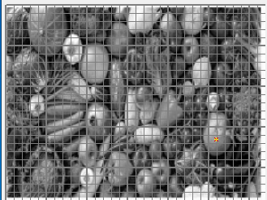
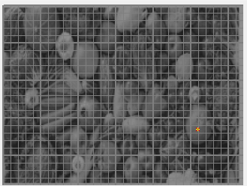
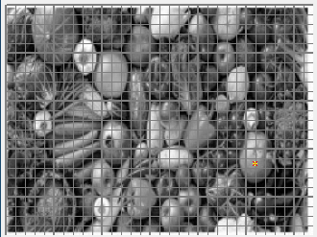
21.8 –conclusions
we can see that the min-max algorithm succeed to fix the spoiling of the gray image. We examine using the profiles one pixel and obviously the restoration succeed upon it.
The row and column profiles also indicate that the min-max is a good restoration – the levels of the grayscale as well as the grayscale usage percentages are same to the original image.
We saw that even major spoiling of the gray image can be restored using min-max algorithm.
We understood that the purpose of the min-max algorithm is to use all the range of the grayscale.
Original gray image
With spoiled_Image algorithm
With min_max_algorithm
Color value for pixel (74,259) is 146
Color value for pixel (74,259) is 94
Color value for pixel (74,259) is 145

Slide 13
21.9 What did we learned
We learned how to implement algorithms and functions that deals with image properties such as: contrast & brightness.
2) We learned how to use the minmax algorithm to “fix” distorted images.
3) We used methods involving LUT which is an essential concept in Image Processing

